Slide 1
Model-Contrastive Federated Learning
Qinbin Li¹, Bingsheng He¹, and Dawn Song²
¹National University of Singapore, ²UC Berkeley
Presented by Rui Chen
CVPR 2021

Slide 2
Outline
Motivation
Model-Contrastive Federated Learning
Experimental Results
Conclusion

Slide 3


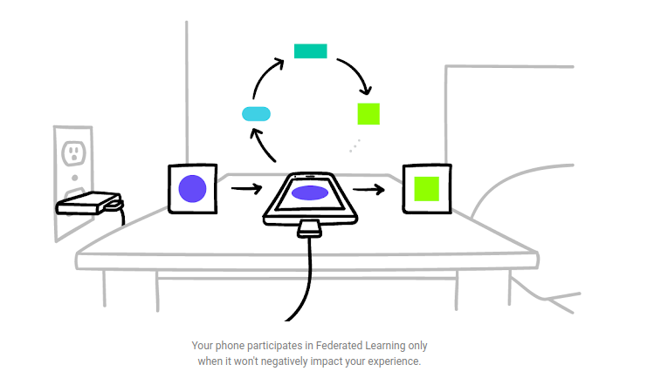



Motivation: Federated Learning
FL Server
…
…
Data never leaves local devices
Learn on fresh real-world data
FL clients

Slide 4
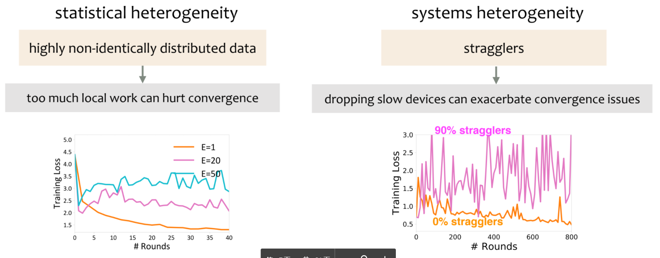
Heterogeneity in FL
Figure from “Learning in Heterogeneous Networks: Optimization and Fairness”

Slide 5
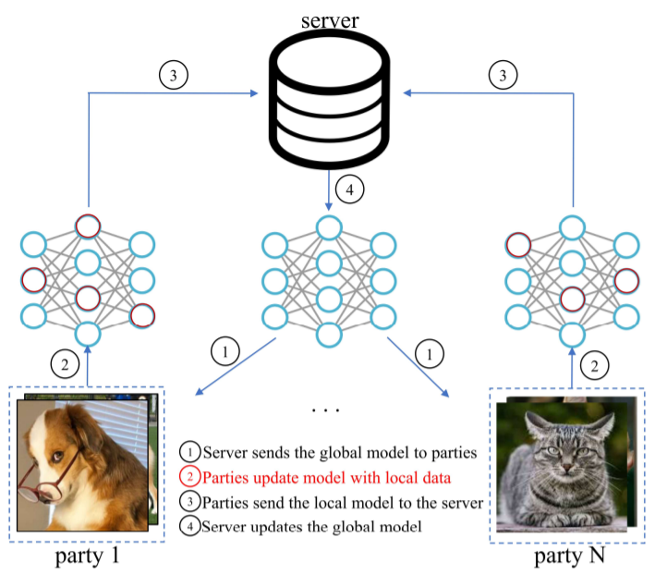
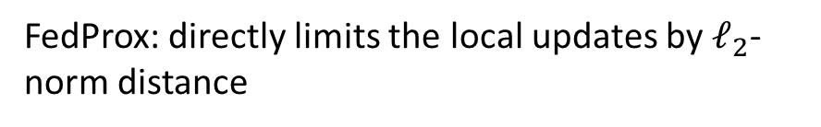
Tackling Non-IID Data
Local update stage
FedProx: directly limits the local updates by $ℓ_{2}$-norm distance
SCAFFOLD: corrects the local updates via variance reduction
Those studies have little or even no advantage over FedAvg when deep models are used for training.
Aggregation stage
FedMA: match and average weights in a layer-wise manner.
FedAvgM: applies momentum for global model updates
FedNova: normalizes the local updates before averaging

Slide 6
Contribution
Address the non-IID issue from a novel perspective, i.e., model representation in the local update stage
Propose model-contrastive learning (MOON), which conducts contrastive learning in model-level by comparing the representations learned by different models.

Slide 7
Outline
Motivation
Model-Contrastive Federated Learning
Experimental Results
Conclusion

Slide 8
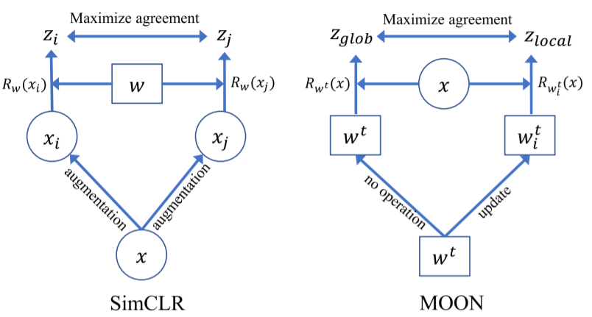
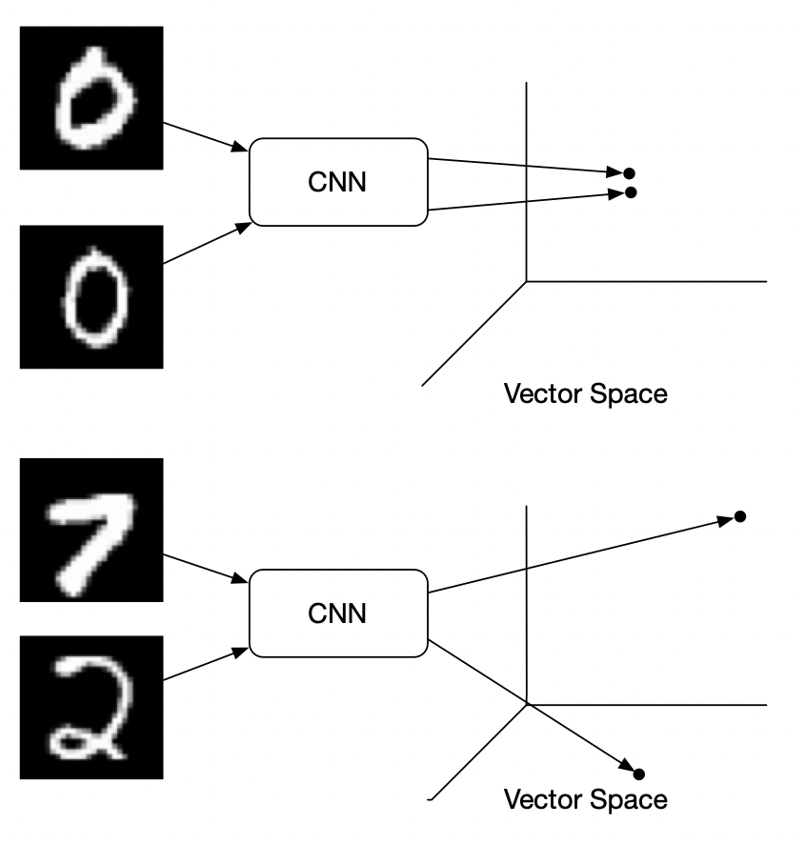
Model-Contrastive Federated Learning
unsupervised learning
Contrastive learning –SimCLR [1]
Positive sample
Negative sample
Data sample
Figure from “Contrastive Loss Explained”
Here x denotes an image, w denotes a model, and R denotes the function to compute representation.
[1] T. Chen, et al. A simple framework for contrastive learning of visual representations. ICML 2020

Slide 9
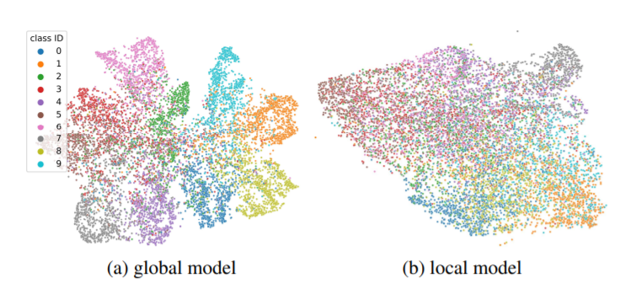
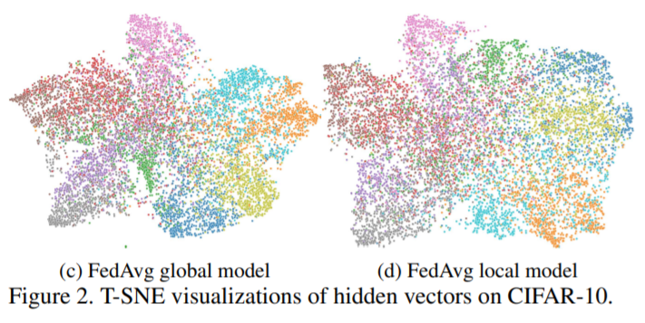
Model-Contrastive Federated Learning
Observation: the global model trained on a whole dataset is able to learn a better representation than the local model trained on a skewed subset.
cannot be distinguished

Slide 10
Model-Contrastive Federated Learning
FedAvg global model can learn better than the local model.
The local training phase even leads the model to learn a worse representation.
divergence

Slide 11
Model-Contrastive Federated Learning
MOON aims to decrease the distance between the representation learned by the local model and the representation learned by the global model
Positive model
Negative model

Slide 12
Model-Contrastive Federated Learning
unsupervised learning
supervised learning
Data sample
model
Here x denotes an image, w denotes a model, and R denotes the function to compute representation.

Slide 13
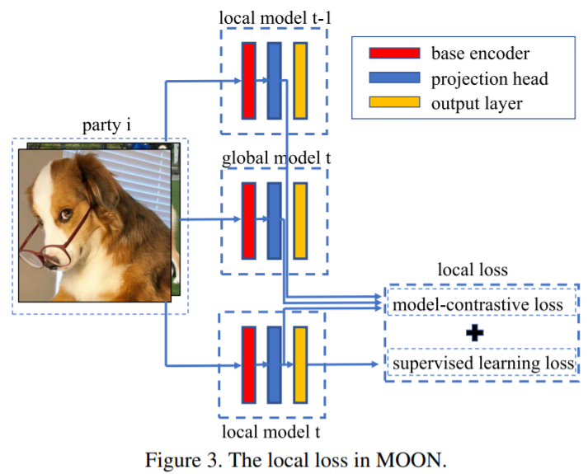
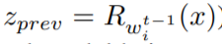
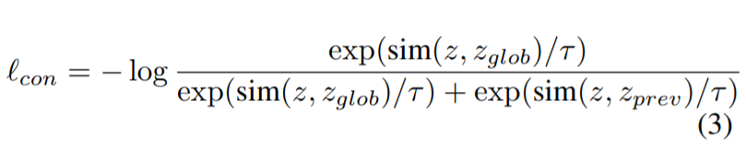
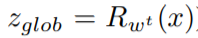
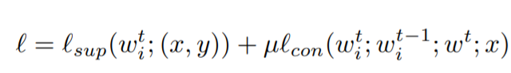
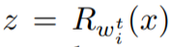
Model-Contrastive Federated Learning
Local training phase
Feature from last local model
Contrastive loss
Feature from global model
Novel Local Loss
Our approach is robust regardless of different amount of drifts.

Slide 14
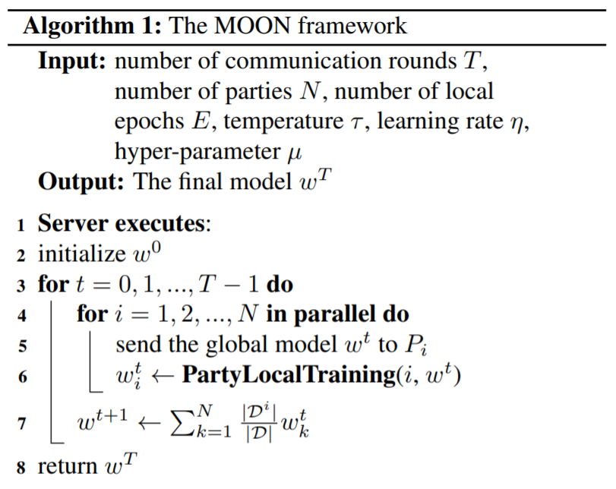
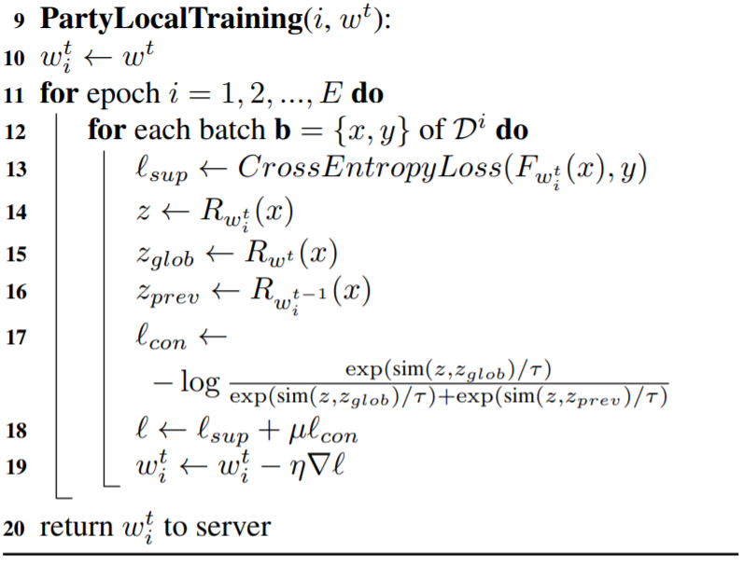
Model-Contrastive Federated Learning

Slide 15
Outline
Motivation
Model-Contrastive Federated Learning
Experimental Results
Conclusion

Slide 16
Experiment Setup
We use PyTorch to implement MOON and the other baselines
Dataset: CIFAR10, CIFAR100, tiny-ImageNet
Encoder: CNN for CIFAR10; ResNet-50 for CIFAR100 & tiny-ImageNet
Data partition: apply Dirichlet distribution (Dir(β)) to generate the non-IID data partition among parties.
A 2- layer MLP is used as the projection head.
Baseline: FedAvg ; FedProx ; SCAFFOLD and Local training

Slide 17
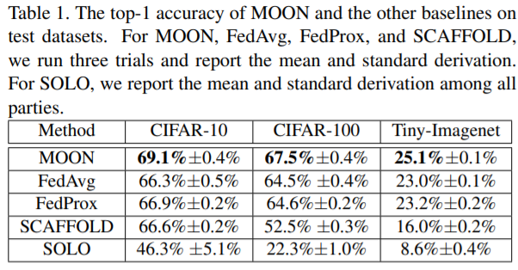
Performance evaluation

Slide 18
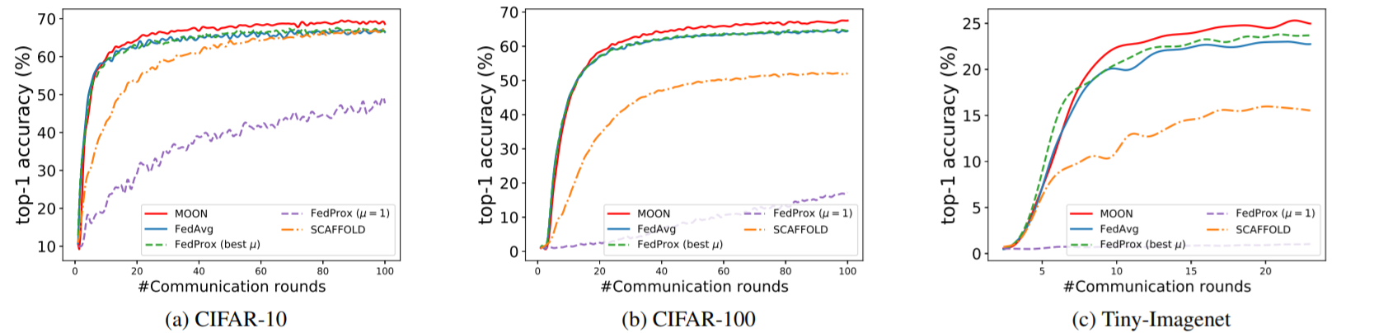
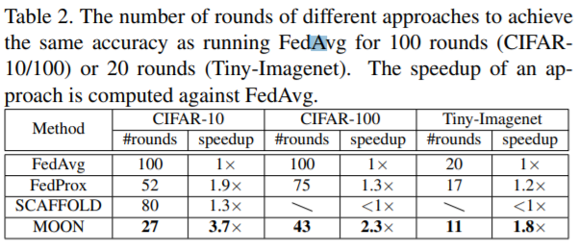
Performance evaluation
MOON is much more communication-efficient than the other approaches.

Slide 19
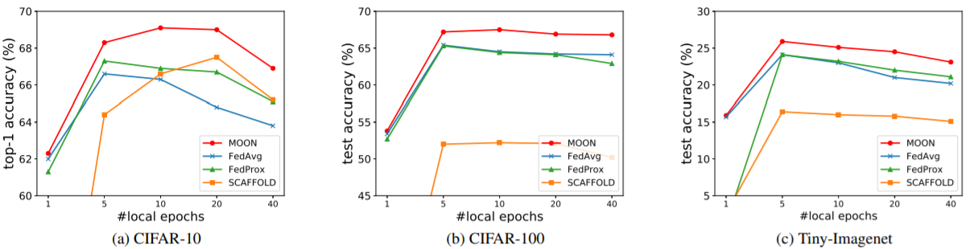
Performance evaluation
MOON can effectively mitigate the negative effects of the drift by too many local updates.

Slide 20
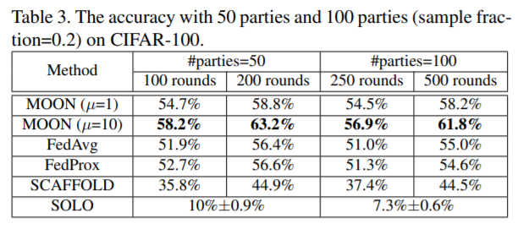
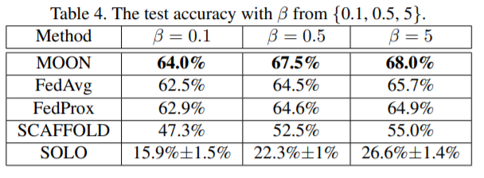
Performance evaluation
Scalability
Diversity
MOON can outperform the other approaches a lot with more communication rounds.

Slide 21
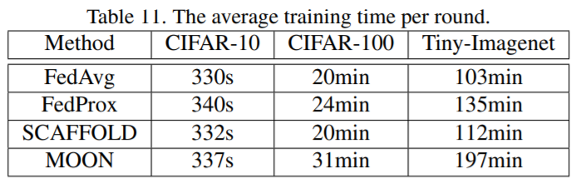
Performance evaluation
The average training time per round

Slide 22
Conclusion
MOON is a simple and effective federated learning framework.
MOON addresses the non-IID data issue with the novel design of model-based contrastive learning.

Slide 24
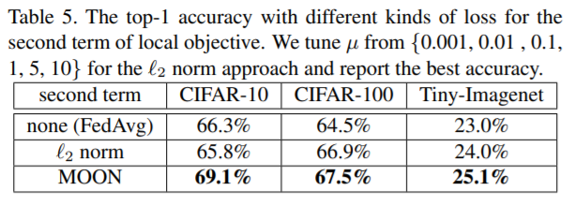
Performance evaluation
Selection of different local loss function

